Slide 1

Walmart Sales
Forecasting
Case Study: ARIMA, SARIMA & Exponential Smoothing Analysis

Slide 2



STRATEGIC OBJECTIVES
Analyze: Evaluate historical sales trends and seasonality patterns.
Model: Implement three distinct time-series forecasting methodologies.
Benchmark: Compare performance metrics (MAE/RMSE) to find the optimal model.
Optimise: Support inventory management and strategic demand planning.

Slide 3






DATA ANALYTICS PIPELINE
1. Preparation
2. Exploration
3. Modeling
Data merging of Sales, Features, and Store datasets. Date conversion and handling of missing markdown values.
Aggregation at the Store level to identify annual cycles and the impact of the "Moving Easter" holiday.
Training ARIMA, SARIMA, and Exponential Smoothing with Damped Trends to ensure stability.

Slide 4


STATIONARITY & DIFFERENCING
Before modeling, we used the Augmented Dickey-Fuller (ADF) test to determine stationarity.
Result: Raw sales data was non-stationary. First-order differencing was applied to stabilize the mean for ARIMA/SARIMA modeling.
Strategy: Data was aggregated to the Store Level to reduce department-specific noise and strengthen the seasonal signal.

Slide 5

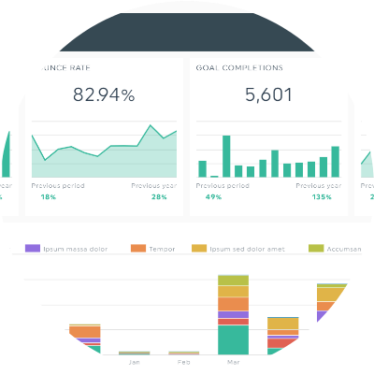
IDENTIFYING SEASONAL PEAKS
Key Sales Drivers
Spring Surges: Major revenue spikes identified in February and April.
Easter Effect: Moving holidays shift peak weeks annually, requiring exogenous modeling.
Markdowns: Promotional discounts correlate strongly with holiday sales volume.

Slide 6



THE MODELING SUITE
ARIMA
SARIMAX
Exp Smoothing
Baseline model. Effective for general trends but failed to capture the high volatility of retail seasonality.
Seasonal extension using Holiday Flags as exogenous variables to anticipate annual spikes.
Holt-Winters method using Damped Trends to prevent forecast explosion in long horizons.

Slide 7


RESOLVING MODEL FAILURE
Initial Challenge
The Fix
Exponential Smoothing forecasts "exploded" into unrealistically high values, while ARIMA flatlined at the mean.
Implementation of Damped Trends for Smoothing and Exogenous Holiday Variables for SARIMAX stabilized all outputs.

Slide 8

PERFORMANCE BENCHMARKING
Forecasting Model | MAE (Mean Error) | RMSE (Squared Error) | Final Status
Exp Smoothing (Damped) | 57,096.41 | 73,251.23 | WINNER
ARIMA (Baseline) | 118,602.74 | 136,571.34 | Underfit
SARIMAX (Holiday-Aware) | 343,727.61 | 347,409.78 | Overfit

Slide 9
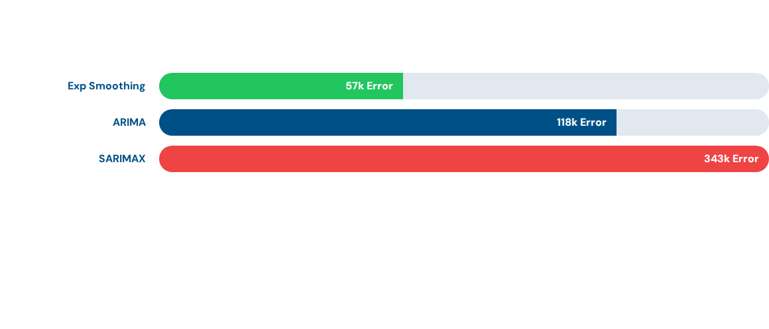
MODEL COMPARISON ANALYSIS
Note: Lower values indicate superior accuracy. Exponential Smoothing showed a 50% improvement over the standard ARIMA baseline.

Slide 10
BUSINESS IMPACT ANALYSIS
1.5x
The Value of Accuracy
Predicting the 50% holiday surge prevents costly stockouts and overstocking. Accurate forecasting with Exponential Smoothing allows for just-in-time replenishment strategies across the retail network.
Sales Multiplier

Slide 11

FINAL CONCLUSION
Best Model: Exponential Smoothing with Damped Trends is the most reliable tool for Store 1.
Seasonality: Deterministic seasonality (Feb/April) is the primary revenue signal.
Strategic Value: Data-driven forecasting directly impacts Supply Chain efficiency.

Slide 12


Questions?
Walmart Sales Forecasting Project Summary

Slide 13




IMAGE SOURCES
https://slidemodel.com/wp-content/uploads/21054-01-growing-timeline-concept-powerpoint-template-1-558x314.jpg
Source: slidemodel.com
https://dashthis.com/media/4150/data-visualization-dashboard.png
Source: dashthis.com
https://anchanto.com/wp-content/uploads/2024/09/anchanto-blog-challenges-in-warehouse-management.jpg
Source: anchanto.com
https://static1.gensler.com/uploads/image/104236/1767051539377/project-walmart-home-office-gay-01-2000x1125.jpg
Source: www.gensler.com

